Slide 1
Database Systems
Lecture 7
Centralized and Client/Server Architecture and Classification of DBMS

Slide 2
Today’s agenda
Centralized and Client/Server Architecture for DBMS
Basic client/server architecture
Two –tier client/server architecture
Three –tier client/server architecture
Classification of DBMS

Slide 3
Centralized and Client-Server Architectures
Centralized DBMS:
Combines everything into single system including- DBMS software, hardware, application programs and user interface processing software.

Slide 4
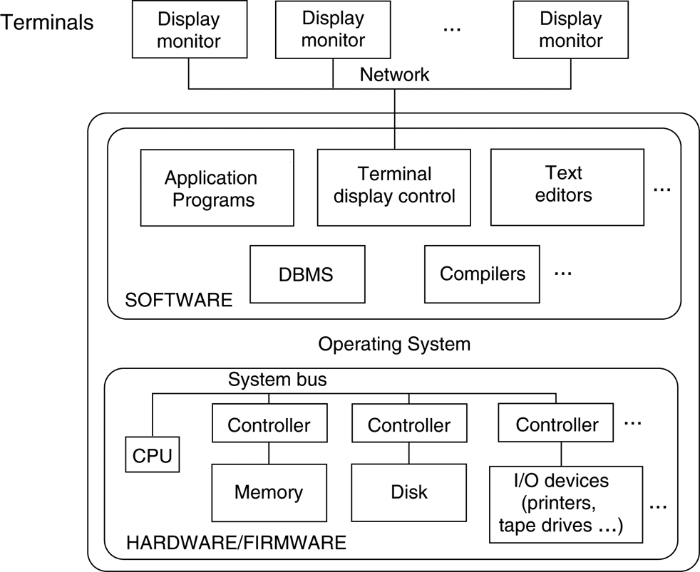
A physical centralized architecture.

Slide 5
Basic Client-Server Architectures
Specialized Servers with Specialized functions
Clients
DBMS Server

Slide 6
Specialized Servers with Specialized functions:
File Servers
Printer Servers
Web Servers
E-mail Servers

Slide 7
Clients:
Provide appropriate interfaces and a client-version of the system to access and utilize the server resources.
Clients maybe diskless machines or PCs or Workstations with disks with only the client software installed.
Connected to the servers via some form of a network. (LAN: local area network, wireless network, etc.)

Slide 8
DBMS Server
Provides database query and transaction services to the clients
Sometimes called query and transaction servers

Slide 9
Two Tier Client-Server Architecture
User Interface Programs and Application Programs run on the client side
Interface called ODBC (Open Database Connectivity ) provides an Application program interface (API), which allows client side programs to call the DBMS. Most DBMS vendors provide ODBC drivers.
A client program may connect to several DBMSs.

Slide 10
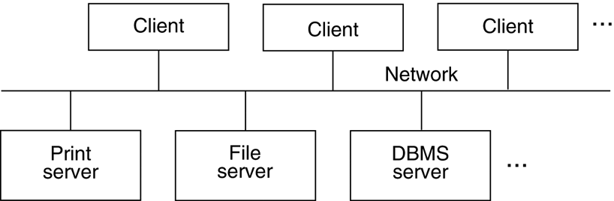
Logical two-tier client/server architecture

Slide 11
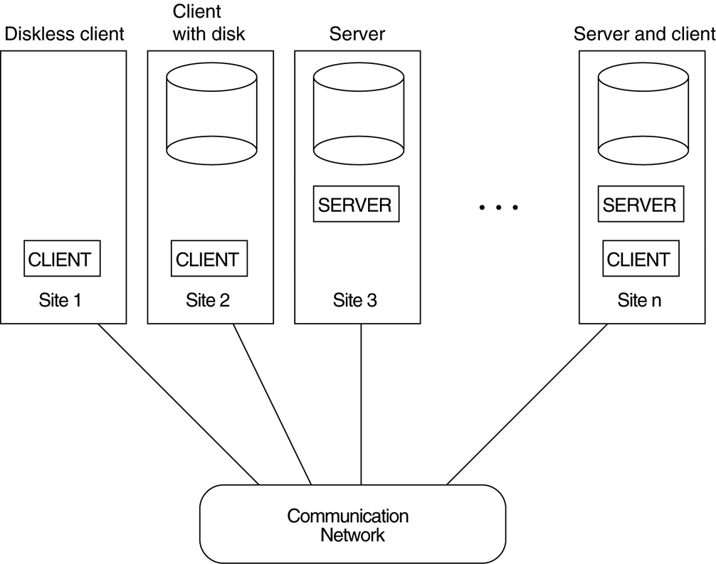
Physical two-tier client-server architecture.

Slide 12
Two Tier Client-Server Architecture
Other variations of client/server architecture are possible: software module of DBMS were divided between client and server in more integrated way, e.g.,
Servers may include the part of DBMS software responsible for handling data storage on disk pages, buffering and caching of disk pages, etc.,
In some DBMSs, more functionality is transferred to clients such as handling user interface, data dictionary functions, concurrency control, optimization and recovery across multiple servers, etc. In such situations the server may be called the Data Server.

Slide 13
Three Tier Client-Server Architecture
Common for Web applications
Intermediate Layer called Application Server or Web Server:
Plays an intermediate role by storing business rules (procedures or constraints) that are used to access data from the database server.
Improves database security by checking client’s credentials before forwarding request to database servers.
acts like a conduit for sending partially processed data between the database server and the client.
User interface, application rules and data access act as the three tiers.
Additional Features- Security:
encrypt the data at the server before transmission
decrypt data at the client

Slide 14
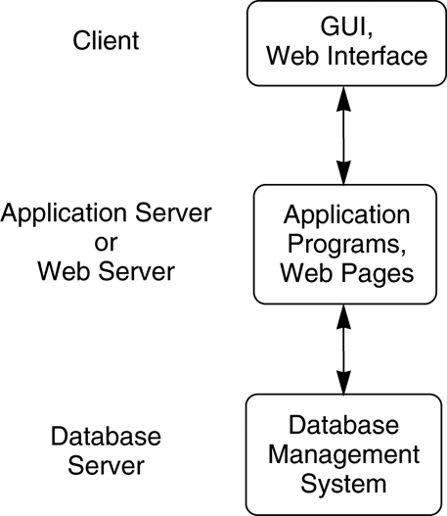
Logical three-tier client/server architecture.

Slide 15
Classification of DBMSs
Several criteria are normally used to classify DBMSs.
Data model
Number of users
Number of sites
Based on purpose

Slide 16
Data Model
Relational model represents a database as a collection of tables, where each table can be stored as a separate file.
Object model defines a database in terms of objects, their properties, and their operations.
Relational DBMSs have been extending their models to incorporate object database concepts and other capabilities; Object-relational model
Network model represents data as record types and also represents a limited type of l:N relationship, called a set type.
Hierarchical model represents data as hierarchical tree structures.

Slide 17
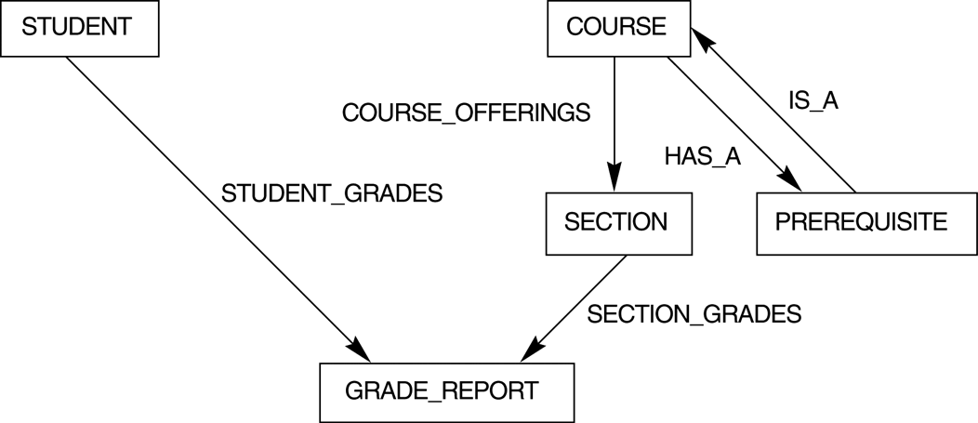
The schema of Figure 2.1 in network model notation

Slide 18
Number of users
Single-user systems support only one user at a time and are mostly used with personal computers.
Multiuser systems, which include the majority of DBMSs, support multiple users concurrently.

Slide 19
Number of sites
A DBMS is centralized if the data is stored at a single computer site.
A distributed DBMS (DDBMS) can have the actual database and DBMS software distributed over many sites, connected by a computer network.
Homogeneous
Heterogeneous

Slide 20
Based on purpose
One well-known family of DBMSs is based on inverted file structures for storing files. Finally, a DBMS can be general purpose or special purpose.
Special purpose DBMS such as airline reservation, telephone directory system, etc., which fall into the category of Online transaction processing (OLTP) systems, i.e., large no-of concurrent transactions.

